Slide 1
EUCALL Mid-Term Review – WP 4
Adrian P. Mancuso – WPL
*
*
*
*
*
Notes:
How to edit the title slide
Upper area: Title of your talk, max. 2 rows of the defined size (36 pt)
Lower area (subtitle): your name and affiliation, max. 1 rows of the defined size (28 pt)

Slide 2

Outline
Main WP objectives
Main WP achievements
  Software developments in SIMEX
  Scientific applications (including extensions from proposal)
Upcoming Milestones and Deliverables
Outlook: SIMEX++

Slide 3

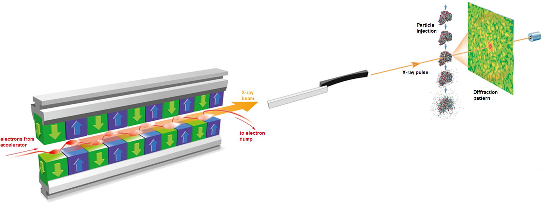
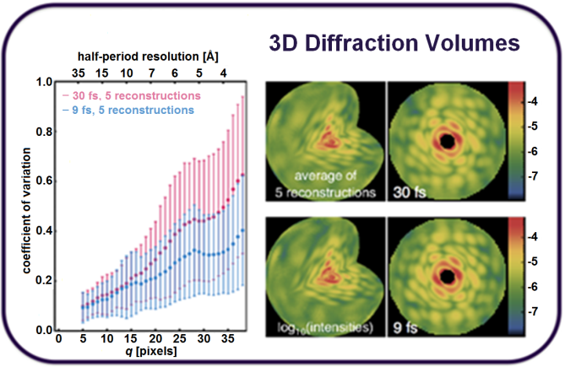
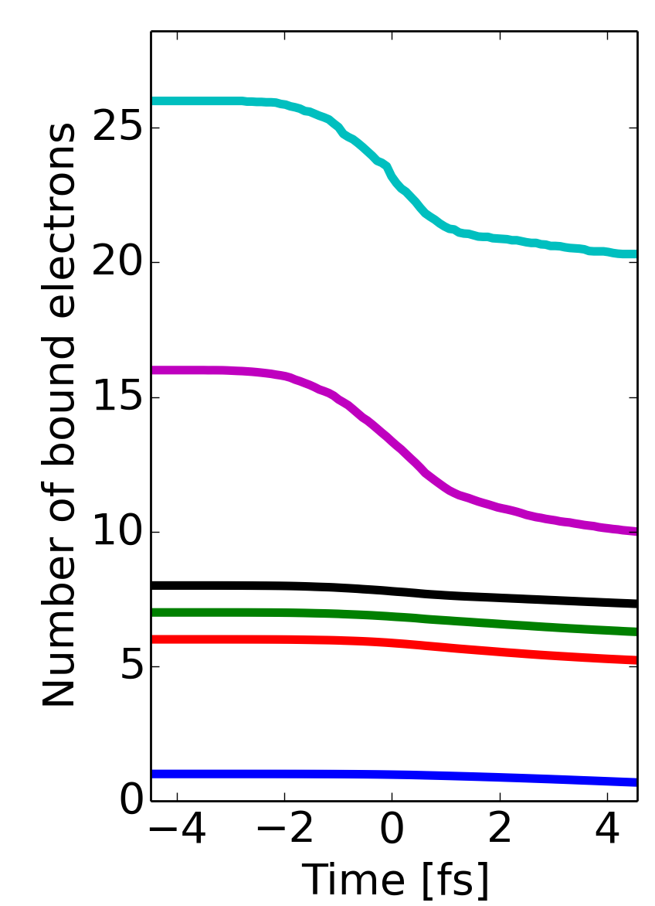
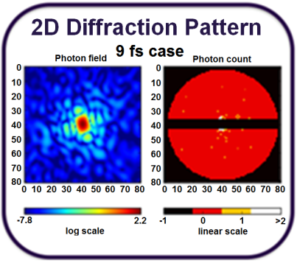
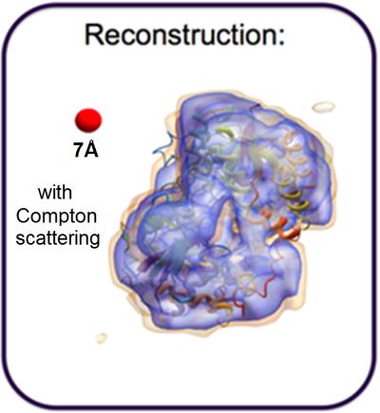
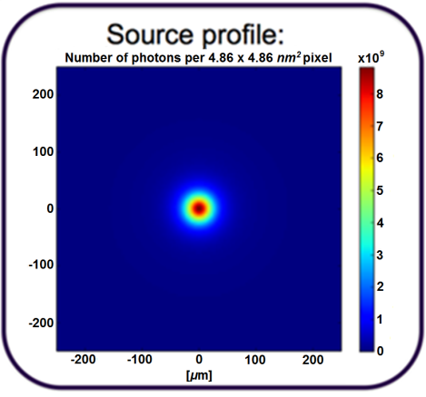
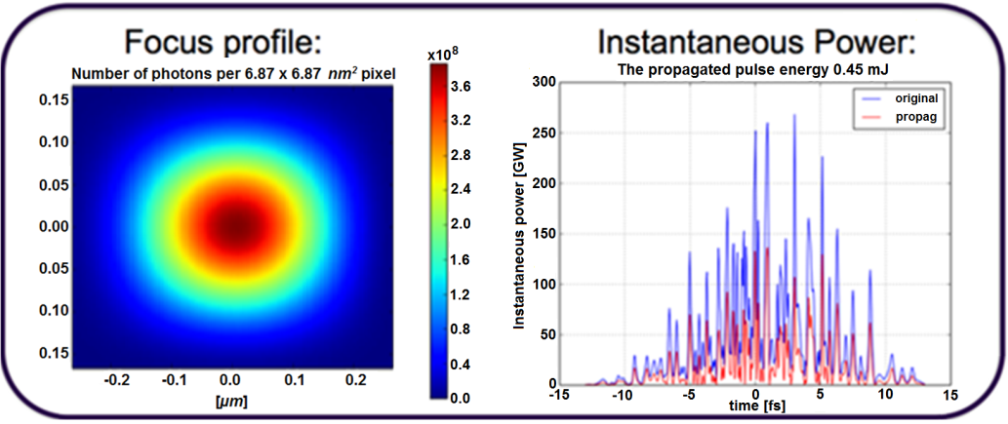
SIMEX' objective
The key objective of SIMEX is to develop a simulation
platform for users and facility operators to simulate
experiments “from source to detector” at advanced
light sources.
Target/Sample
Atoms, molecules, clusters
Solids, surfaces
Liquids
Plasmas
Yoon et al. Scientific Reports 6 24791 (2016)
Fortmann-Grote et al. NOBUGS (2016)
Photon Data Analysis
Structure determination
Electronic structure
Transport
Relaxation &
Thermodynamics
Fortmann-Grote et al. SPIE Proceedings (2017)
Diagnostics
Spectroscopy
Diffraction
Scattering
Photon propagation
Lenses
Mirrors
Apertures
Gratings
Monochromators
Coherent, incoherent
Photon Source
XFEL
Synchrotron
Optical Laser
Pump-probe

Slide 4
The dimensions of SIMEX
Research Infrastructures
Research Areas
Visualization
HPC
SIMEX
Data handling
User Interfaces
Frameworks
Validation

Slide 5
Timeline
Software development Reports & data generation
D1: Short pulse laser matter interaction software
M1: Single modules interoperable
D2: Long pulse laser matter interaction software
M2: First example simulation
2016
M3: Simulations interoperable
D3: Interoperability of simulation workflows
70%
50%
2017
D4: Generation of coherent scattering data
50%
D5: Testing & validation
20%
2018
M4: Tested and documented simulation code
10%

Slide 6
Publications out of SIMEX
C. Fortmann-Grote et al., Start-to-end simulation of single particle imaging using ultra-short pulses at the European X-ray Free Electron Laser, IUCrJ (submitted)
C. Fortmann-Grote et al., Simulations of ultrafast x-ray laser experiments, SPIE Optics & Optoelectronics Conference Proceedings, Prague (2017)
C. Fortmann-Grote et al., SIMEX: Simulation of Experiments at Advanced Light Sources, in “New Opportunities for Better User Group Software” Conference Proceedings, 29 (2017); doi:10.17199/NOBUGS2016.21 (published May 2017)
E. Zenker et al., Alpaka – An Abstraction Library for Parallel Kernel Acceleration 2016 IEEE International Parallel and Distributed Processing Symposium Workshops, (IPDPSW) 00: 631-640 (2016); doi: https://doi.org/10.1109/IPDPSW.2016.50
E. Zenker et al., Performance-Portable Many-Core Plasma Simulations: Porting PIConGPU to OpenPower and Beyond, Lecture Notes in Computer Science, 9945: 293-301 (2016); doi: http://dx.doi.org/10.1007/978-3-319-46079-6_21

Slide 7
SIMEX provides user interfaces and data formats for start-to-end photon experiment simulations
Photon source
FEL
Synchrotron
Plasma source
Optical Laser
Photon propagation
Wave Optics
Ray optics
Photon-Matter Interaction
Molecular Dynamics
Particle-In-Cell
Radiation-Hydrodynamics
Source radiation field
Focus radiation field
Sample trajectory
Electronic structure
Atom positions
Density, temperature, pressure
Data analysis
Structure finding
Dynamics
Thermodynamics
Detector
Pixel area detector
Spectrometer
Photon scattering,
emission, absorption
Results
Detector response
Photon-Matter interaction products
Scattered photons
Emitted photons
Secondaries (e⁻, ions)
Calculators: Scriptable (python) interfaces to advanced simulation codes
Data interfaces using metadata standards

Slide 8
Simulation codes in SIMEX

Slide 9
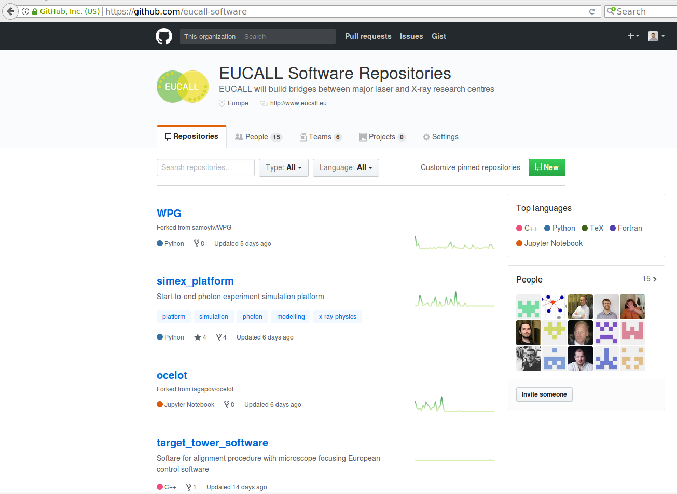
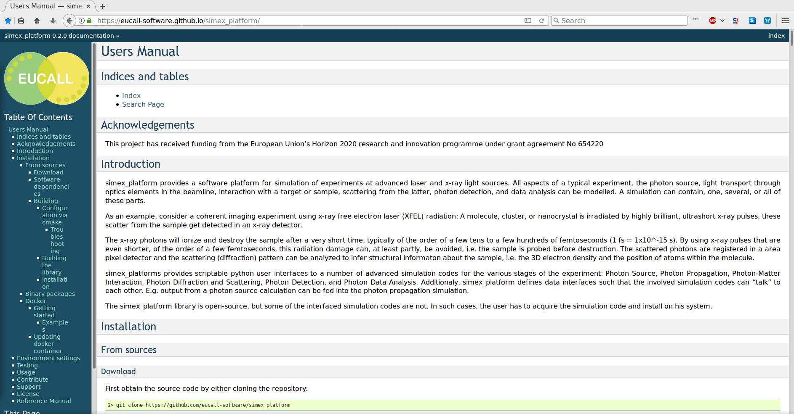
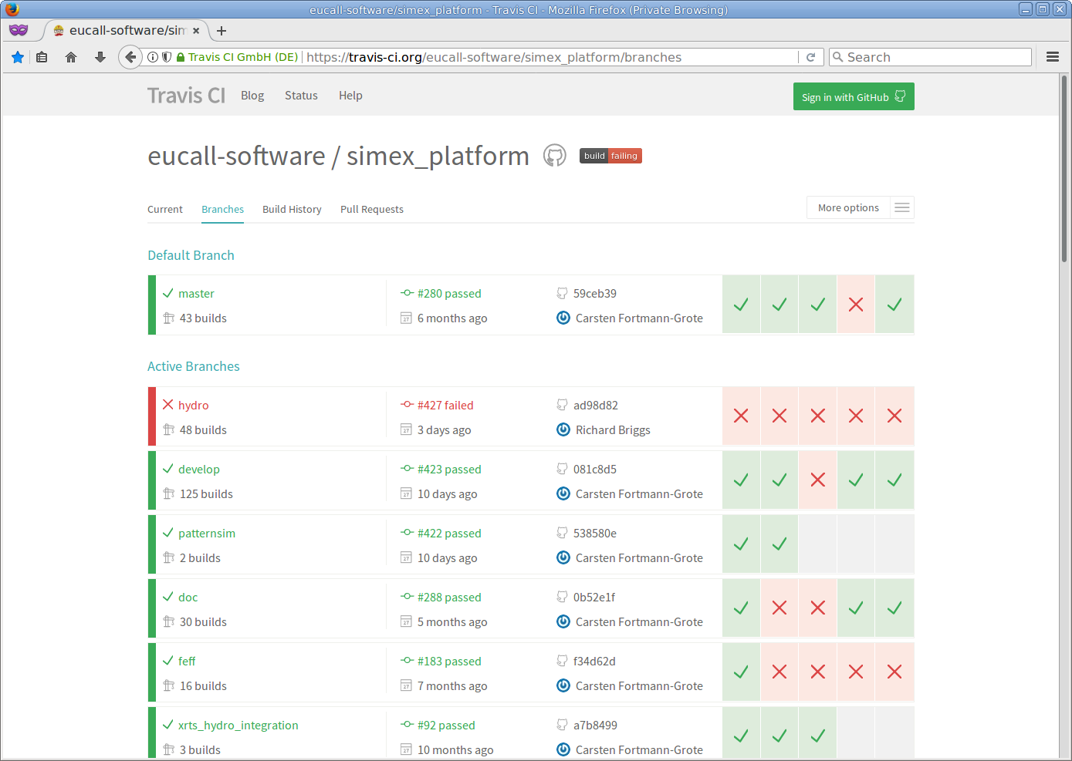
SIMEX is developed as an opensource
project on github

Slide 10
Remaining tasks in FY2

Slide 11
M36 deliverables and milestones
D4.5/Task 4.3.1: , Benchmarking, testing, validation, example workflow
    Validation against Virus data (AMO@LCLS)
    Validation against C60 data (CXI@LCLS)
    Iterative optimization workflow: Target design for dynamic compression experiments
    Performance benchmarks for selected simulation codes
Task 4.3.2: HPC, data management, data analysis
    SIMEX codes run on modern HPC infrastructures including GPU clusters
    Deployment options: source tarballs, binary packages, docker images
    Webbased SIMEX frontend under development

Slide 12
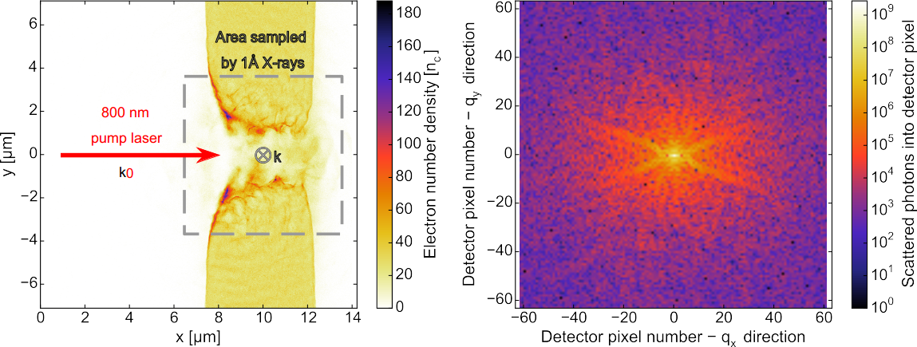

SAXS on high-power laser driven solid targets
Target: 5 μm cryogenic hydrogen
Laser: 800 nm, 30 fs, 105 TW
Probe: 1 Å, 10¹² photons / 50 μm² focus
2D PIC simulation
R.Mishra,Phys.Plasma 20,072704(2013).
SAXS pattern 134 fs after laser pulse
Detector distance 93 cm
Avg. photon count: 10^{5..6} / pixel
SAXS simulation: paraTAXIS code

Slide 13
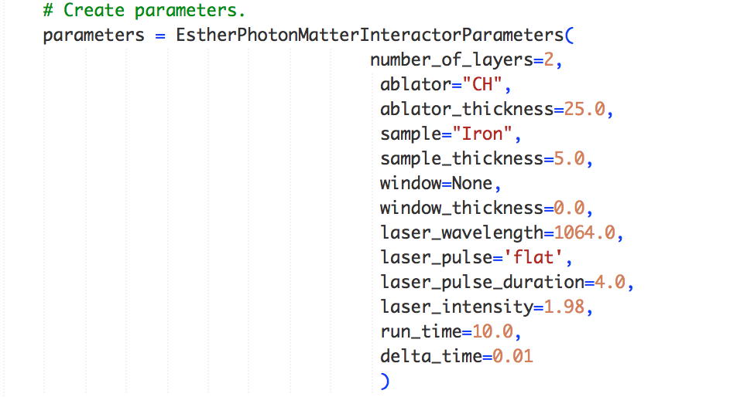
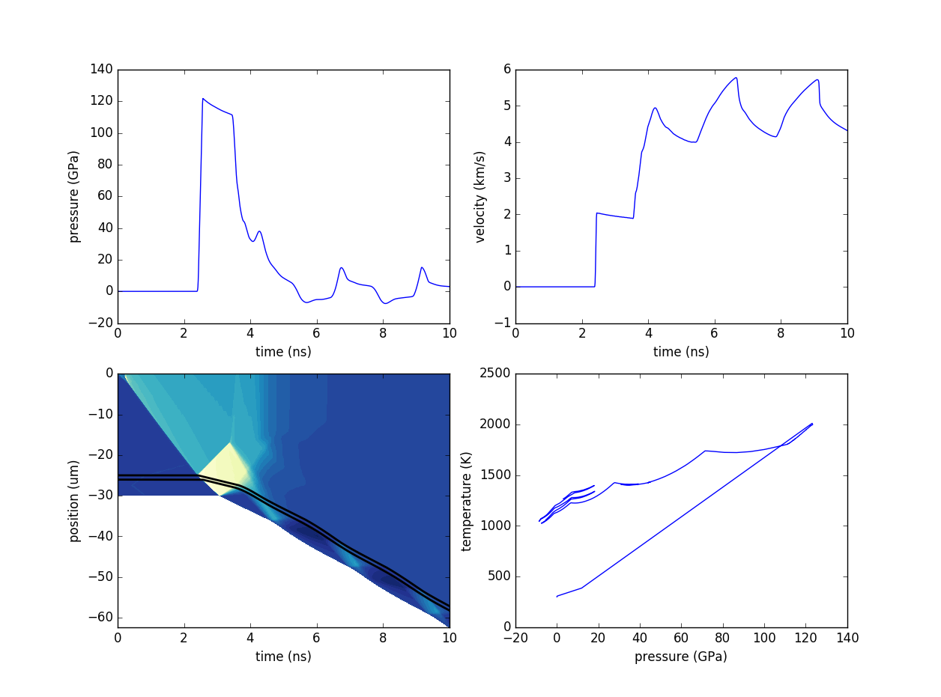
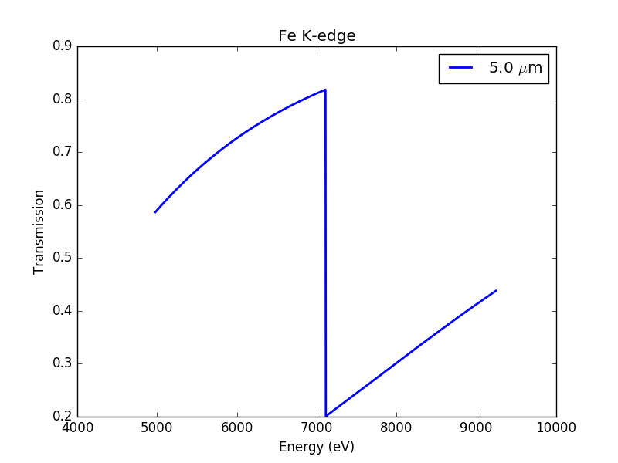
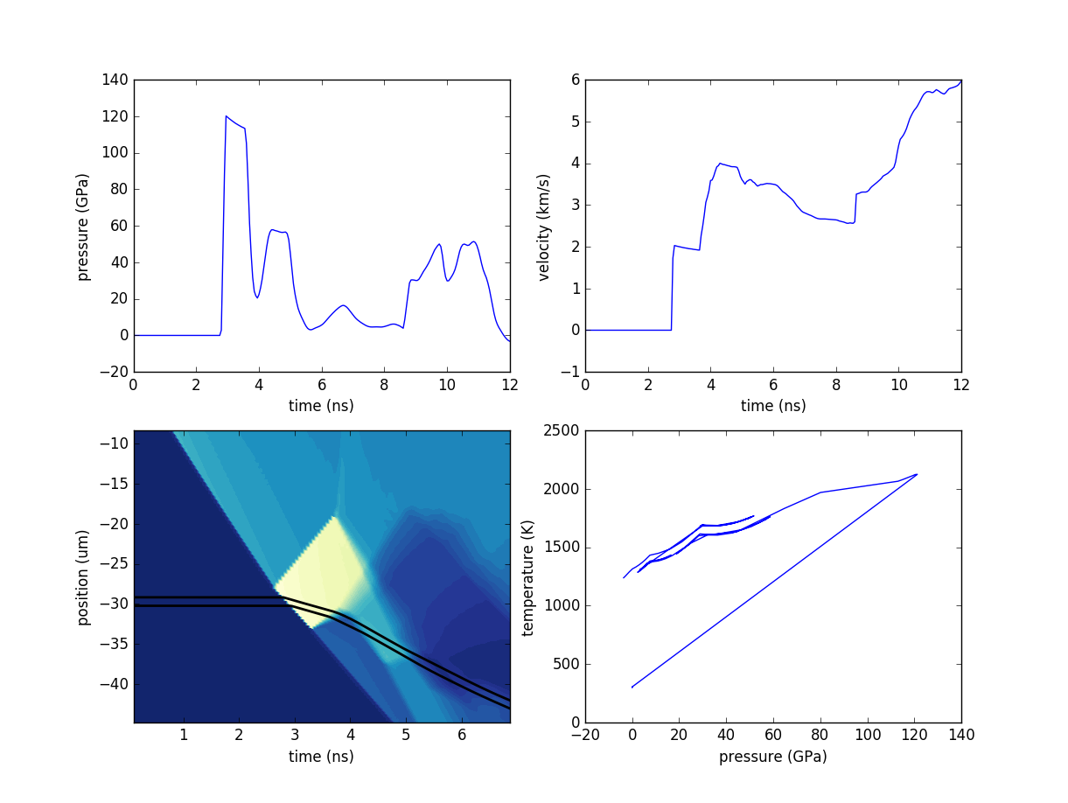
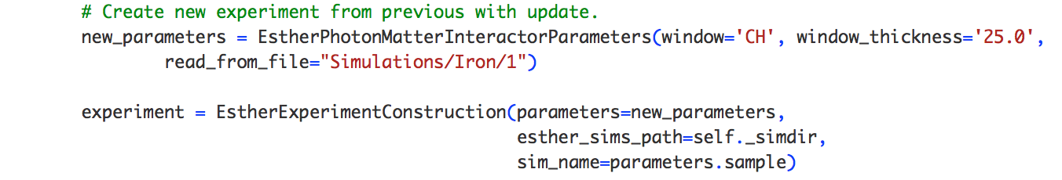

SIMEX assists in target design optimization for dynamic compression experiments at ESRF
5 µm Fe
25 µm CH
1064 nm
4 ns
1.98 TW/cm²
→ Setup calculation parameters →Run calculation → Analyze results →
Initial sample target design.
5 µm Fe
←Re-design (add window layer to confine target) ←
25 µm CH
25 µm CH
1064 nm
4 ns
1.98 TW/cm²
→ Update calculation parameters →Run calculation → Analyze results →

Slide 14
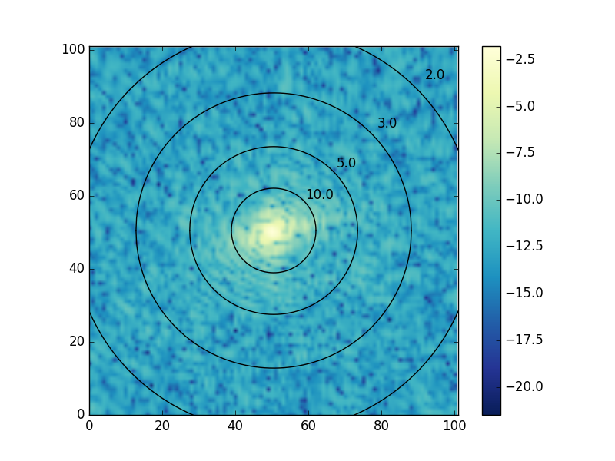
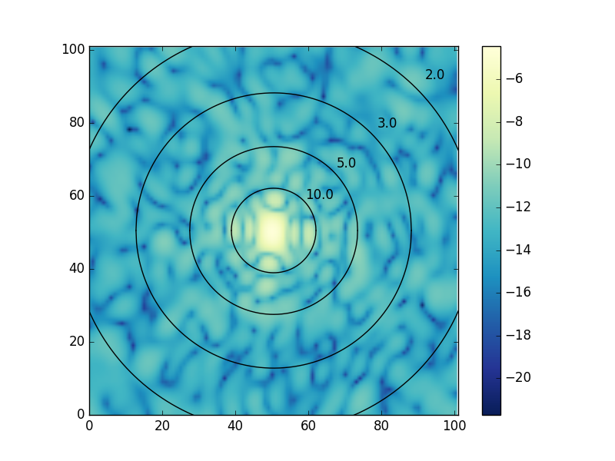
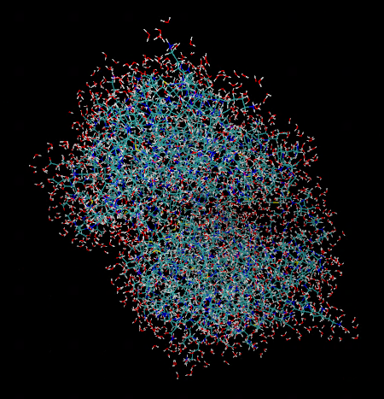
Single particle imaging of biomolecules
2NIP + 3Å H₂O
pure protein (2NIP)
2NIP imaging at various pulse duration: C. Fortmann-Grote et al. (under review).

Slide 15
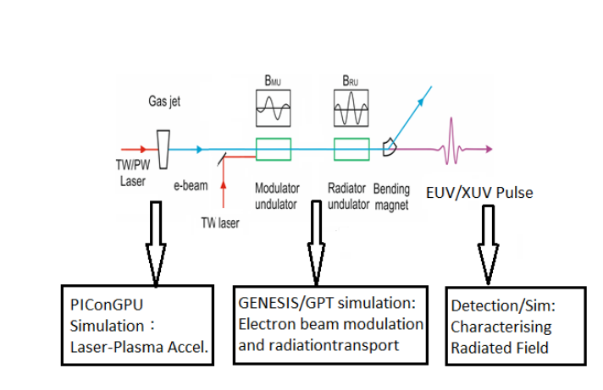

Laser-plasma acceleration based x-ray source
Simulate laser wakefield acceleration (PIC)
Feed electrons into FEL simulation code
New and hot topic, extension of EUCALL proposal

Slide 16

Summary and Conclusions
SIMEX achieved Milestones and Deliverables up to date.
On track for M24 Ms&Ds.
M36 Ms&Ds are in progress.
simex_platform is exploited for scientific output.
Future plans for SIMEX are beginning to emerge.

Slide 17
Benchmarking Experiments Against Modeling and Simulation (BEAMS)
Close the loop between experiments and theory by benchmarking experiments against detailed simulation in the photon sciences
Include other “beam-like” fields: e.g. neutron, astro, HEP
modeling experiments feasible at today’s facilities and benchmarking the results of experiments to the modeling
  improved understanding of physics
  more accurate forward models of physical phenomena
Include rapid data analysis
  Feedback for potentially data hungry experiments.
Potential (natural) partners
  EUCALL: SIMEX , UFDAC
  CFEL, ILL, MAX IV, ESS
  Astronomy/Astrophysics groups, HEP community

Slide 18



SIMEX as a Service
Backend daemons
Authorize user
Find resource
Organize data transfer
Submit job to resource
Provide job status
Submit job
BATCH
HPC
CLOUD

Slide 19
Thank you for your attention
www.eucall.eu / contact@eucall.eu
Notes:
How to edit the title slide
Upper area: Title of your talk, max. 2 rows of the defined size (36 pt)
Lower area (subtitle): your name and affiliation, max. 1 rows of the defined size (28 pt)

